Slide 1
Lecture3 Initiation Phase (Cont)
Reading: Main text, Chp5&6; Sup text, Chp 5
Lek Hsiang Hui

Slide 2
Outline
System Use Cases
Event Decomposition
Identify Actors
Identify System Use Cases

Slide 3
System Use Cases
System Use Cases
Identify Actors
Identify System Use Cases
Event Decomposition

Slide 4
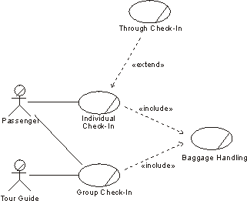
Recall: Business Use Cases
A business use-case diagram provides an overview of business processes and the entities involved in the processes

Slide 5

System Use Cases
Goal: Translate Business Use Cases into System Use Cases

Slide 6

So what are system use cases?

Slide 7
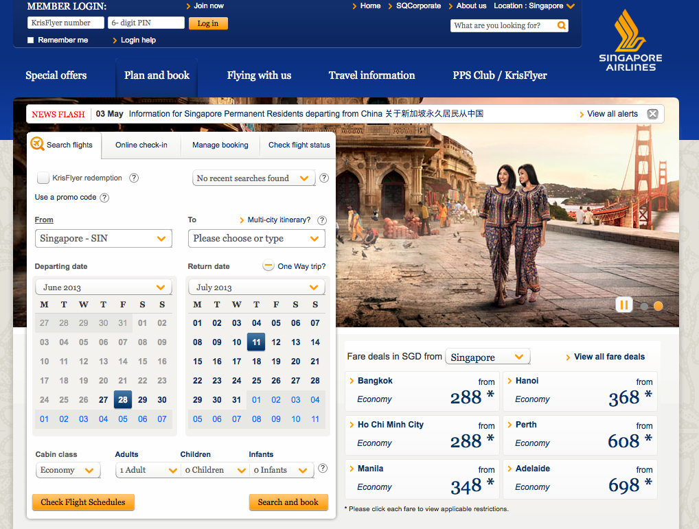
What can users do (with the system?
Focus on the users’ perspective

Slide 8
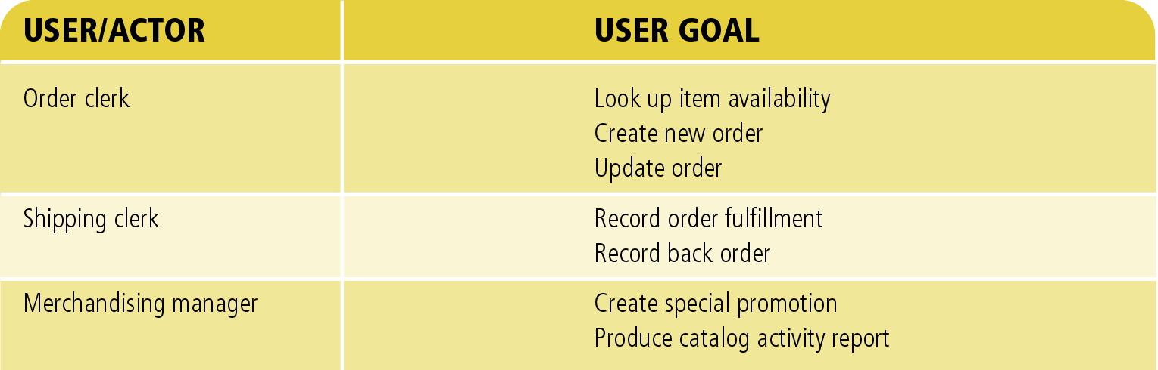
Users and their Goals

Slide 9
Event Decomposition
System Use Cases
Event Decomposition
Identify Actors
Identify System Use Cases

Slide 10

Events
An event can happen at a specific time/place
Should be remembered by the system
Trigger processing in the system

Slide 11

Event Decomposition
How to identify Events?
One approach is Event Decomposition

Slide 12
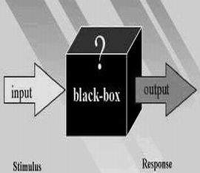
Event Decomposition
How to identify Events?
One approach is Event Decomposition
Treat system as a black box

Slide 13

Event Decomposition
List of system use cases triggered by business events

Slide 14
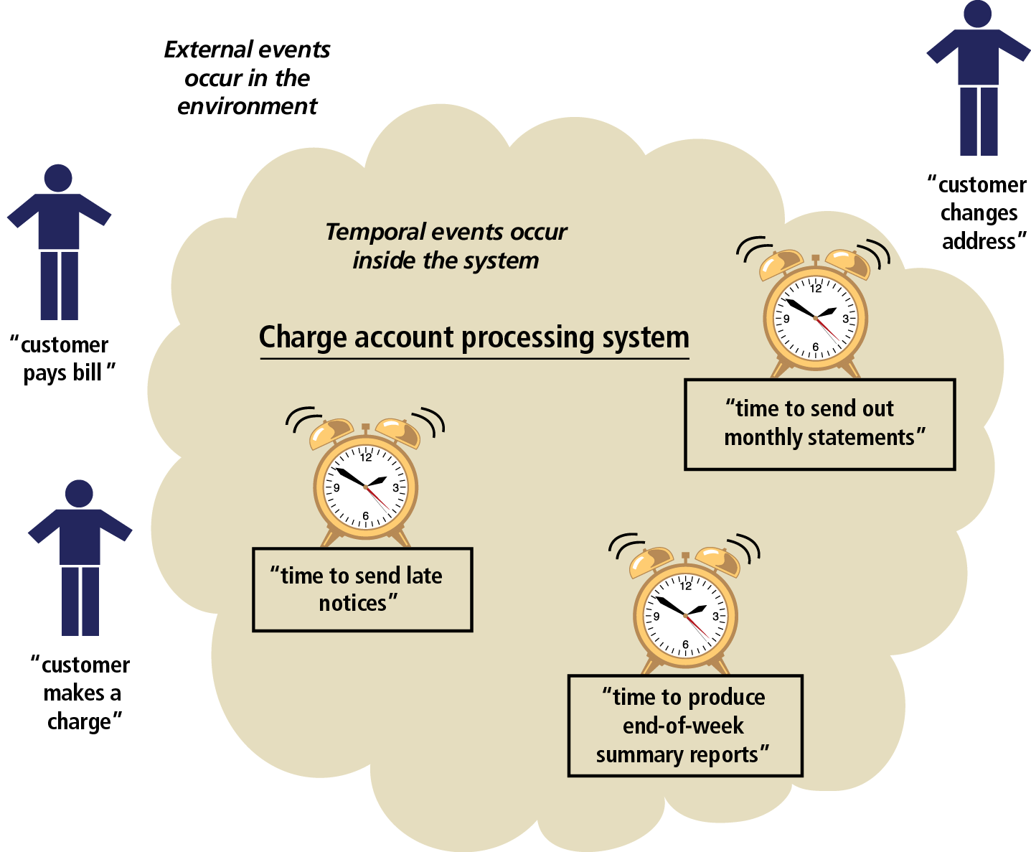
Events Affecting a Charge Account Processing System that Lead to Use Cases
Customer triggers 3 events: makes a charge, pays a bill, changes address
System responds with 3 use cases: process a charge, record a payment, maintain customer data
System responds with 3 use cases: produce monthly statements, send late notices, produce summary reports
3 other events triggered inside the system by time: time to send out monthly statements, time to send late notices, time to produce end-of-week summary reports

Slide 15

3 types of Events
External Events
Occur outside the system
Usually caused by external agent e.g. customer
Temporal Events
Occurs when system reaches a point (deadline) in time
State Events
Events that occur when something happen inside the system that trigger the need for processing

Slide 16
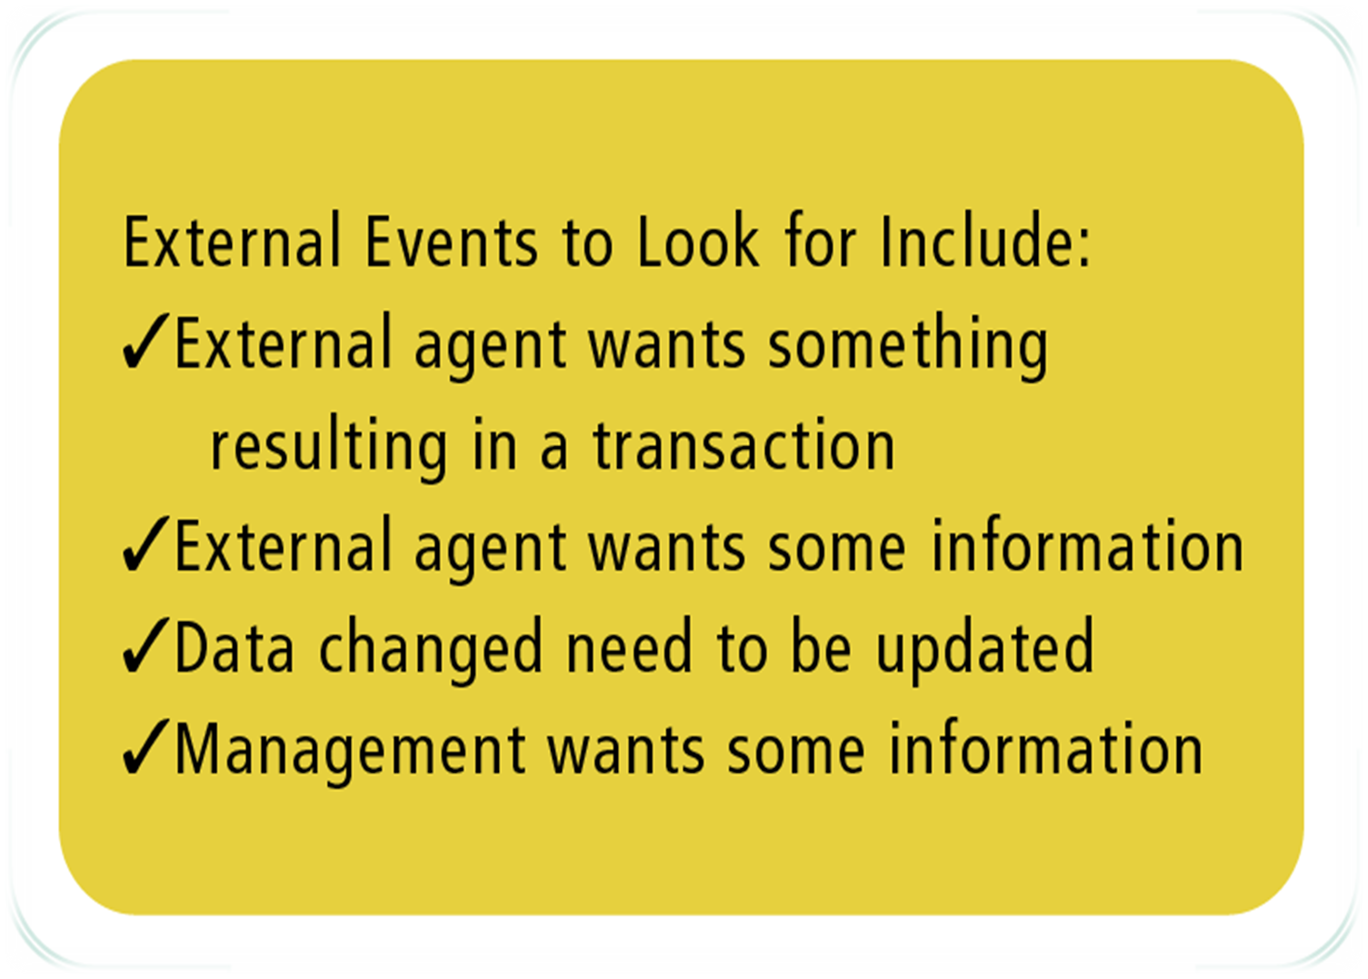
External Event Checklist

Slide 17
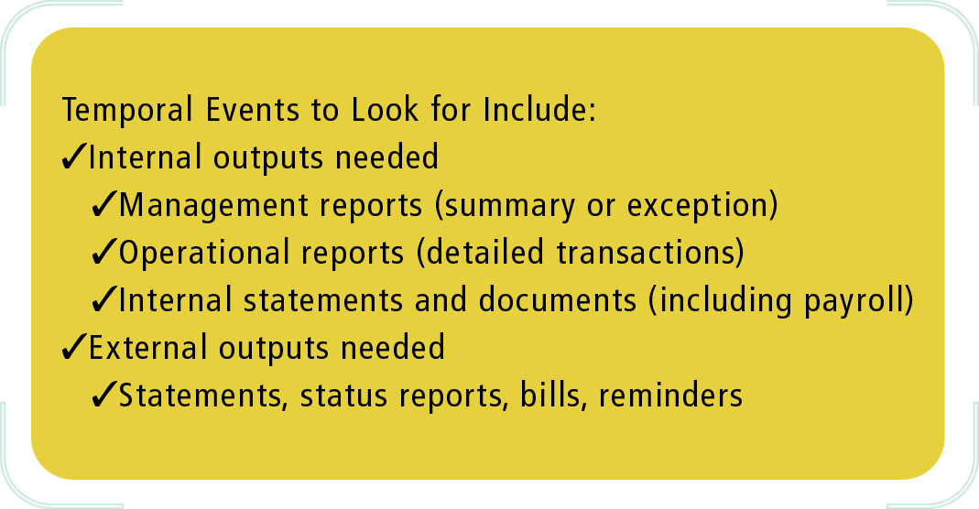
Temporal Event Checklist

Slide 18
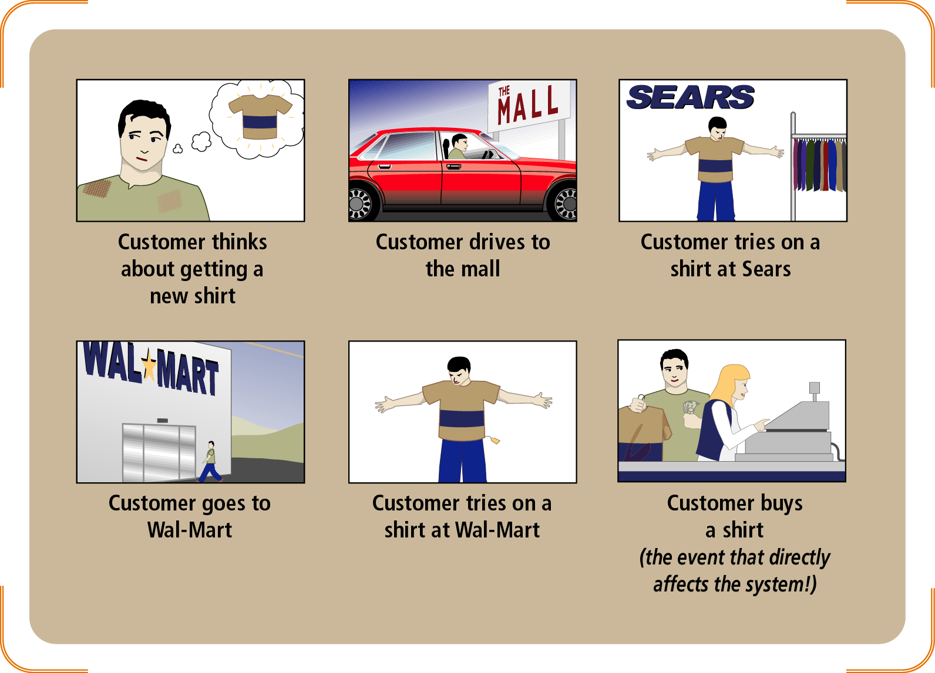
Note about identifying events
Distinguish events from prior conditions and responses
Sequence of actions that leads up to only one event affecting the system

Slide 19
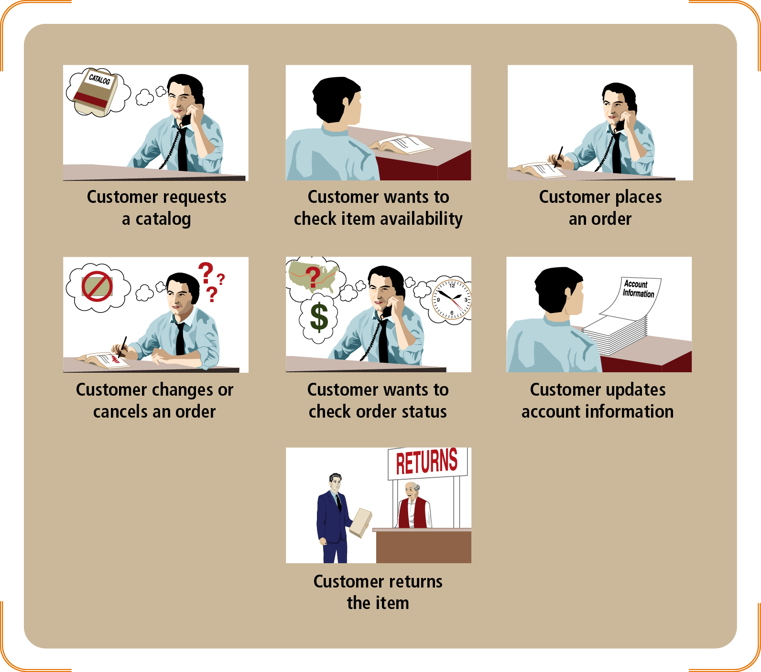
Note about identifying events
Isolate events that actually touch the system
There might be many real-world events but we are only interested in the one that actually affects/touch the system

Slide 20
Note about identifying events
Perfect technology assumption:
Unlimited processing and storage capacity
Equipment does not malfunction
Users have ideal skill sets

Slide 21

Rocky Mountain Outfitter Case Study
Rocky Mountain Outfitters (RMO) is a sports clothing distributor
Significant regional distributor
Employs more than 600 people
$100 million annual sales

Slide 22

What do you think are some of the events applicable to RMO?

Slide 23
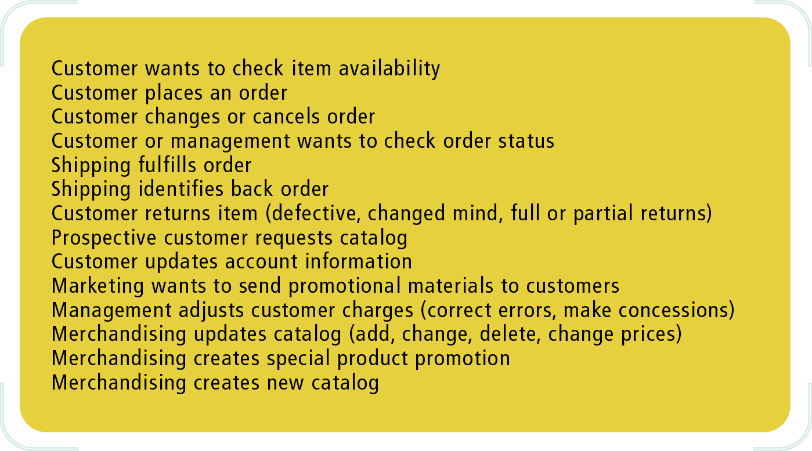
Events in the Rocky Mountain Outfitters Case
Developing list of external events
Identify all people and organizational units that want something from the system

Slide 24
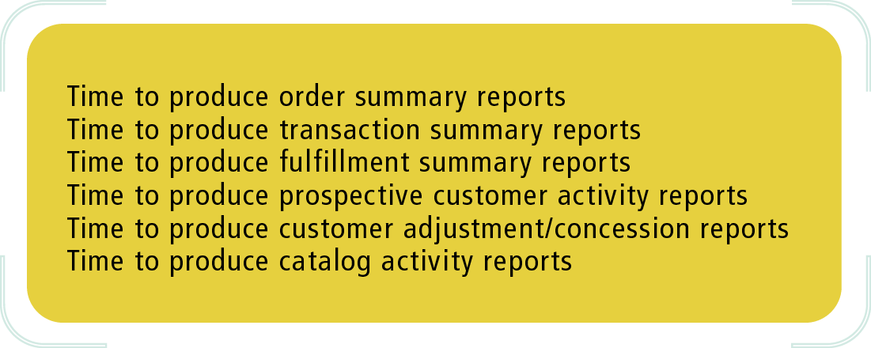
Events in the Rocky Mountain Outfitters Case
Developing list of temporal events
Identify regular reports and statements that system must produce at certain times

Slide 25
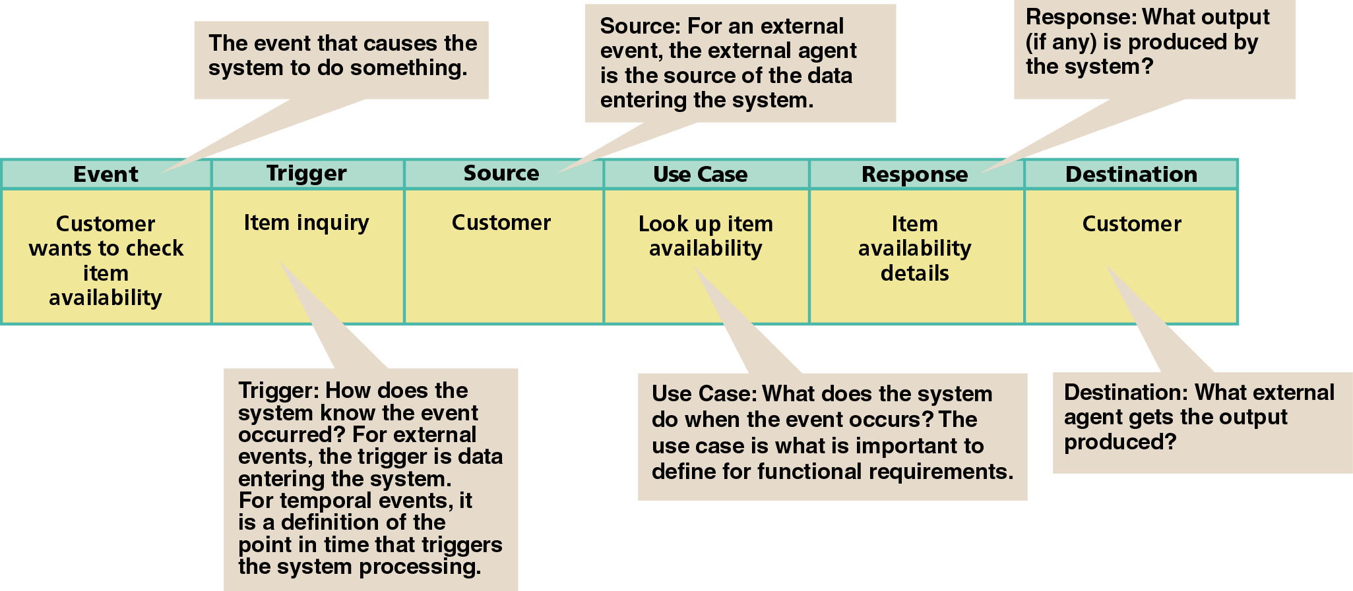
Record information about event in a Event Table

Slide 26
Customer Support System Event Table
EVENT | TRIGGER | SOURCE | USE CASE | RESPONSE | DESTINATION
1. Customer wants to check item availability | Item inquiry | Customer | Look up item availability | Item availability details | Customer
2. Customer places an order | New order | Customer | Create new order | Real-time link Order confirmation Order details Transaction | Credit bureau Customer Shipping Bank
3. Customer changes or cancel order | Order change request | Customer | Update order | Change confirmation Order change details Transaction | Customer Shipping Bank
4. Time to produce order summary reports | “End of week, month, quarter, and year” |  | Produce order summary reports | Order summary reports | Management
5. Time to produce transaction summary reports | “End of day” |  | Produce summary transaction reports | Transaction summary reports | Accounting
6. Customer or management wants to check order status | Order status inquiry | Customer or management | Look up order status | Order status details | Customer or management

Slide 27
Customer Support System Event Table
EVENT | TRIGGER | SOURCE | USE CASE | RESPONSE | DESTINATION
7. Shipping fulfills order | Order fulfillment notice | Shipping | Record order fulfillment
8. Shipping identifies back order | Back-order notice | Shipping | Record back order | Back-order notification | Customer
9. Customer returns item | Order return notice | Customer | Create order return | Return confirmation Transaction | Customer Bank
10. Time to produce fulfillment summary reports | “End of week, month, quarter, and year” |  | Produce fulfillment summary reports | Fulfillment summary reports | Management
11. Prospective customer requests catalog | Catalog request | Prospective customer | Provide catalog info | Catalog | Prospective customer
12. Time to produce prospective customer activity reports | “End of month” |  | Produce prospective customer activity reports | Prospective customer activity reports | Marketing
13. Customer updates account information | Customer account update notice | Customer | Update customer account

Slide 28
Customer Support System Event Table
EVENT | TRIGGER | SOURCE | USE CASE | RESPONSE | DESTINATION
14. Marketing wants to send promotional materials to customer | Promotion package details | Marketing | Distribute promotional package | Promotional package | Customer and prospective customer
15. Management adjusts customer charges | Customer charge adjustment | Management | Create customer charge adjustment | Charge adjustment notification Transaction | Customer Bank
16. Time to produce customer adjustment/concession reports | “End of month” |  | Produce customer adjustment reports | Customer adjustment reports | Management
17. Merchandising updates catalog | Catalog update details | Merchandising | Update catalog
18. Merchandising creates special product promotion | Special promotion details | Merchandising | Create special promotion
19. Merchandising creates new catalog | New catalog details | Merchandising | Create new catalog | Catalog | Customer and prospective customer
20. Time to produce catalog activity reports | “End of month” |  | Produce catalog activity reports | Catalog activity reports | Merchandising

Slide 29
System Use Case Diagram

Slide 30
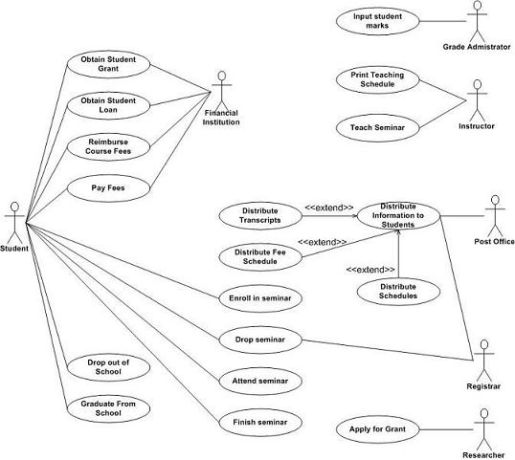
An example of System Use Cases
Taken from http://www.agilemodeling.com/artifacts/useCaseDiagram.htm

Slide 31
Without moving forward, are you able to understand the system use case diagram?

Slide 32
Recall: Business Use Cases
A business use-case diagram provides an overview of business processes and the entities involved in the processes
Notice how similar the notations are?

Slide 33
System Use Cases
Like business use cases, these system use cases can be represented using use case diagram/use case descriptions
Steps
Identify actors
Identify system use cases
Associate actors with use cases
Organizing use cases

Slide 34
Identify Actors
System Use Cases
Identify Actors
Identify System Use Cases
Event Decomposition

Slide 35
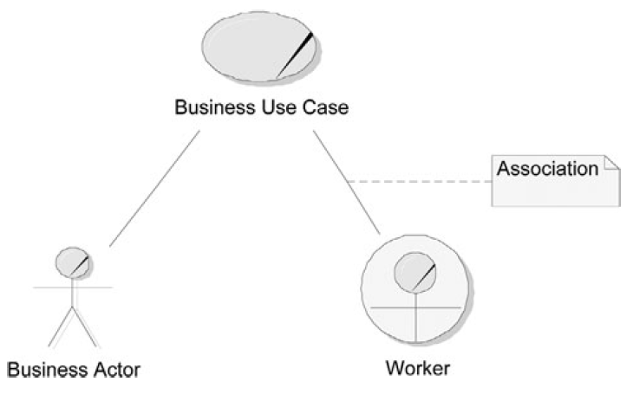
Recall: Business Use Case Diagram
Recall: In business use case modeling, we make use of Business Actor and Worker
System use case modeling is focused on “what the system can do” (as opposed to Business Use case)
Actors = Users of IT System

Slide 36

Identify Actors
Can be users of the IT system
Or other system that interacts with the IT system

Slide 37

Questions to ask
What will the system be like?
Who are the possible users?
Is there just one system or many subsystems
How does the system interact with other systems?

Slide 38
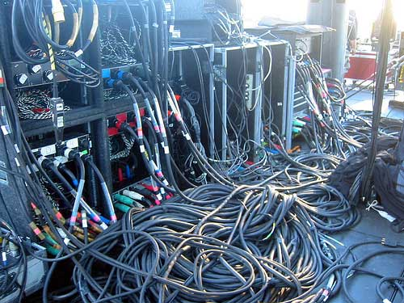
Questions to ask
What will the system be like?
Should roughly have an idea

Slide 39
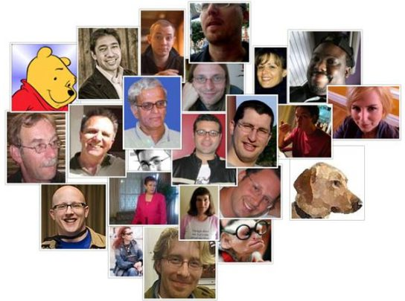
Questions to ask
Who are the possible users?
Customers?

Slide 40

Questions to ask
How are the different types of customers using the system?
Customers?
How many types of customers are there?

Slide 41

Questions to ask
Employees?
Who are the other possible users?
How is the accountant using the system?
How are the managers using the system?

Slide 42
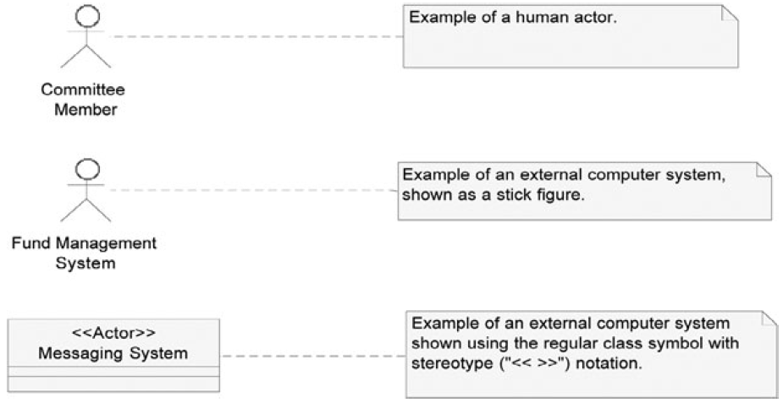
Actor
Notice any difference compared to business actor?

Slide 43
Stereotypes
Stereotype = Extension of a UML feature
Can invent their own stereotypes to create extended meanings to UML model elements
E.g. <<Actor>>, <<Interface>>, etc

Slide 44
Generalize Actor
After identifying the actors
Generalize them
i.e. find relations amongst these different types – e.g. A manager is a more specific kind of clerk – Think object-oriented!
Note that actors can also be systems

Slide 45
Role Map
A diagram used to standardize the treatment of users and external systems
Unlike use-case diagram, only shows actors and how actors are related

Slide 46
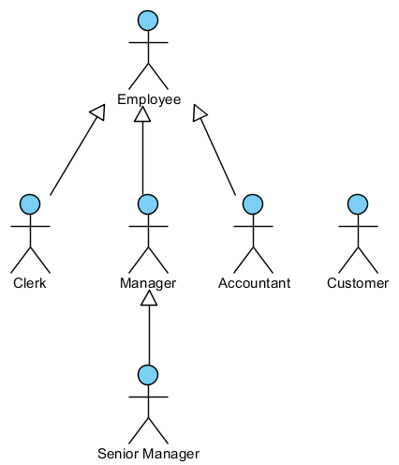
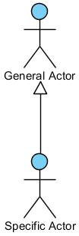
Role Map
Recall: Superclass and subclass in OO programming

Slide 47
Role Map
The arrow allows use to model actors with overlapping roles
Think of the generalization relationship arrow as “a kind of”
Example: Clerk, Manager, Accountant are different kind of Employer, Senior Manager is a kind of Manager

Slide 48
Role Map
General
More Specific
More Specific => they can do more things
Even More Specific

Slide 49
Generalization and Specialization
Specialized actors inherit the ability to do all the things that a generalized actor can do
Think Object-Oriented programming
Clerk extends (inherits) Employee
Employee = Generalized actor
Clerk = Specialized actor

Slide 50

Modeling Generalized/Specialized Actors
2 types of situations:
Actors whose roles partially overlap
An actor whose role completely encompasses another’s

Slide 51
Actors with Partially Overlapping Roles
Example Scenario:
IT manager and HR manager are both manager
They have the usual access rights a manager should have e.g. access to their team members’ data
Each of them have their own set of functions on the system specific to their department
Every manager in the company must belong to at least 1 department
IT manager
HR manager
manager

Slide 52
Actors with Partially Overlapping Roles
Can model the manager actor as an abstract actor
More specifically abstract generalized actor
The term abstract means that the invented actor is not real (i.e. the abstract actor is never instantiated)
The abstract actor is not a true role but an abstract concept meant to represent the shared aspects of other roles
Cannot instantiate abstract actor: new manager();
Need to instantiate this instead:
new itManager();
new hrManager();

Slide 53
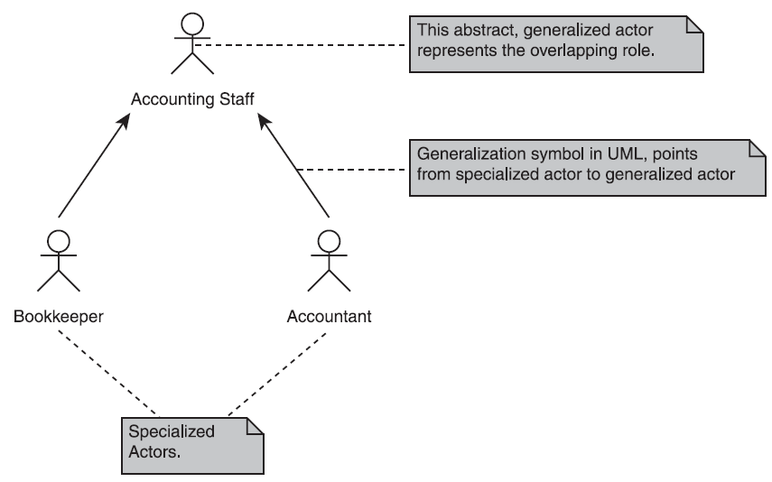
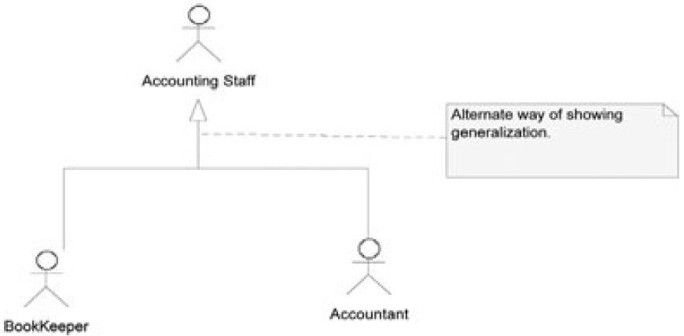
Actors with Partially Overlapping Roles
In use cases, you won’t usually see the abstract actors

Slide 54
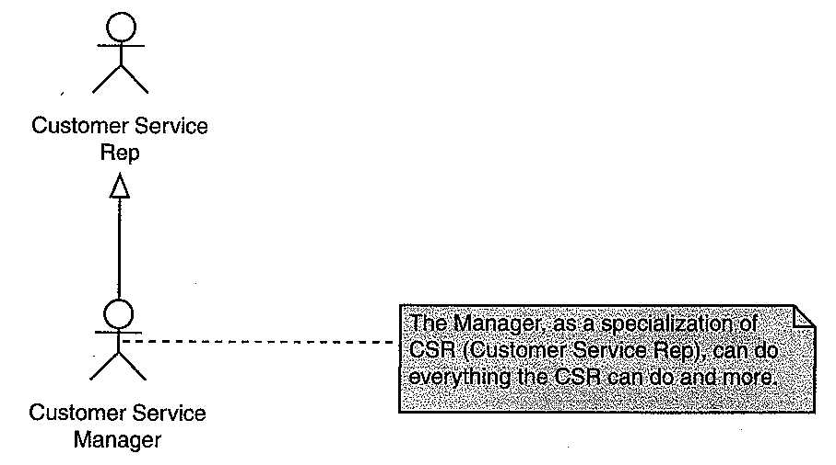
Modeling an Actor Whose Role Totally Encompasses Another’s
An actor might be able to do everything that another actor can do and more
Only one subclass
Model the actor with the restricted role as the generalized actor, and model the actor with the larger role as the specialized actor

Slide 55
Concrete Generalized Actor
A generalized actor may represent a real-world user role
In this case, the generalized actor is not an invention but a real role
Concrete: opposite of abstract
It is therefore considered to be a concrete (as opposed to abstract) actor

Slide 56
Why do we define generalized actors

Slide 57
Why do we define generalized actors?
Simplify
Reduce the number of association lines (just connect to the generalized actor
Simplify the drawing of use case diagram

Slide 58
Identify System Use Cases
System Use Cases
Identify Actors
Identify System Use Cases
Event Decomposition

Slide 59
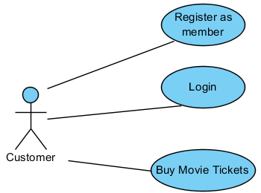
Identify System Use Cases
A system use case is an interaction between an actor and a computer system
Go back to the business use cases and review the activities they describe

Slide 60
Identify System Use Cases
Once you have identified the activities, group them into system use cases:
How will someone sitting at a terminal actually use the system?
What result is the user trying to achieve from the computer system with each interaction?
Each of these results, expressed as a user goal, is a system use case
For example, for a Web banking system, some system use cases are View Transaction History, Transfer Funds, and Pay Bill

Slide 61
Features of System Use Cases
The system use-case approach involves diagrams and text
Definition of a use case focuses on describing the interaction that the user has with the system
The use case is usually verb-based
E.g. “Register as user”, “Login”, ....

Slide 62
System Use Case Modeling Elements
Primary Actor: An actor who initiates a use-case interaction.
System use case: A user task (indicated as an oval)
Can draw with either a line or arrow pointing to the the use case

Slide 63
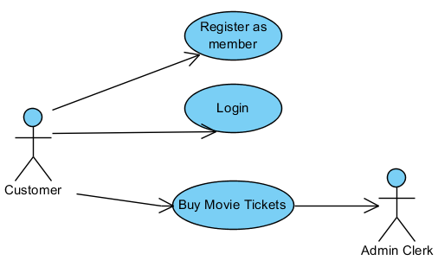
System Use Case Modeling Elements
Secondary Actor: An actor that the system initiates an interaction with after the use case has started
Draw with arrow pointing from use case to secondary actor

Slide 64
What’s Next?
Use Case Description

